Slide 1
Clustering Cryptocurrencies by Behavioral Patterns
Data Science and Machine Learning: ML Group 10
Unsupervised Learning to Uncover Hidden Market Structures
Aya Abu Allan Anitha Aravindaraman Puneet Arora Tom Konikkara Xavier Redhead

Slide 2
As of 2024, over 23,000 cryptocurrencies exist—but more than 80% have little to no active trading volume or utility.
(Source: CoinMarketCap, archived data)

Slide 3
What is Crypto
‘Crypto’ are digital currencies in which transactions are verified and records maintained by a decentralized system using cryptography, rather than a centralized authority.
More traditional financial institutions are starting to include dedicated crypto trading desks (Goldman Sachs), custody solutions (BNY Mellon) and blockchain pilot programs.
Digital assets expected to become more and more integral to the global financial landscape
Governments are introducing regulatory frameworks (E.U. MiCA, U.S. GENIUS Act signed July 18, 2025)

Slide 4
Motivation
Crypto market is vast, volatile, unstructured
Thousands of coins with varying behaviour
Price-based grouping is misleading
Investors and researchers would benefit from behavioural groupings

Slide 5
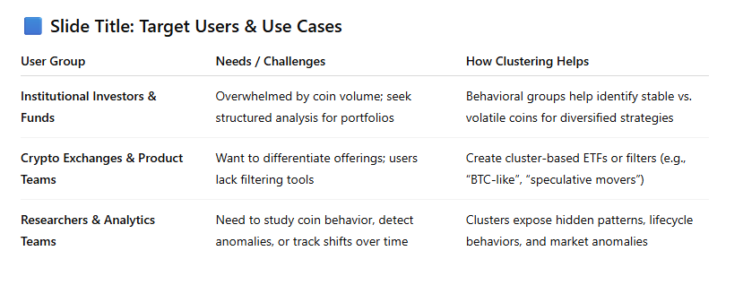
Business Use Cases

Slide 7
Dataset Overview
Kaggle - All Cryptocurrencies by JesseVent
~1,584 unique coins across ~620,000 records
Time range: Apr 2013 – Nov 2018
Key features: open, high, low, close, volume, market, close_ratio, spread

Slide 8
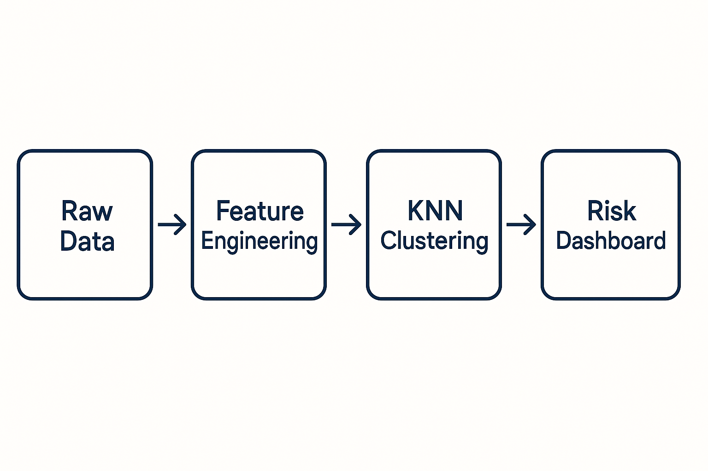
Raw Data to Risk Profiles
Processed historical price and technical data for 100+ coins across time windows
We extracted signals: volatility, spreads, momentum, liquidity
We then grouped coins into risk-based clusters using unsupervised learning
Notes:
We processed historical price and technical data for 100+ coins across time windows.
We extracted signals: volatility, spreads, momentum, liquidity.
We then grouped coins into risk-based clusters using unsupervised learning.

Slide 9
Feature Engineering
What extra features were added
Time series analysis

Slide 10
Clustering Approach
Describe the model and evaluator decisions

Slide 11
Results
Include diagrams/plots

Slide 12
Cluster Interpretation
Describe the model, scorer, other decisions

Slide 13
Challenges and Potential Improvements
What went wrong? What we do differently
No ground truth/ lack of domain knowledge
Nature of market to follow favoured coins
Add more recent data through API
Segment by rolling window
Other clustering algos: DBSCAN, Agglomerative, HDBSCAN…

Slide 14
xx%
Use this slide to show a major stat. It can help enforce the presentation’s main message or argument.
Make the crypto market more accessible to risk-averse investor

Slide 15
This is the most important takeaway that everyone has to remember.

Slide 16

Thanks!
Any questions?

